Slide 1
GO Team Meeting #1
William M. Boyd
September 25, 2025

Slide 2
Agenda
Call to Order
Roll Call; Establish Quorum
Action Approval of Agenda
  Approval of Previous Minutes:
  Additional Action Item 1: Vote on Community and Parent Vacancy
Discussion Items
  School Strategic Plan
    Strategic Plan & Priorities Review
    SMART Goals
  Data Discussion
    MAP Results
    2025 GA Milestones Results
Information Items
  Principal’s Report
    Enrollment and Leveling Updates
    Additional Information Items
  APS Forward 2040 –Comprehensive Long-Range Facilities Plan Update
Announcements
  Bring Your Parent to School (9am – 11pm)
  Friday, September 26, 2025
  IHG Sponsor – Urban Recipe will distribute the food (11am – 1pm)

Slide 3
2021-2025
Strategic Plan

Slide 4
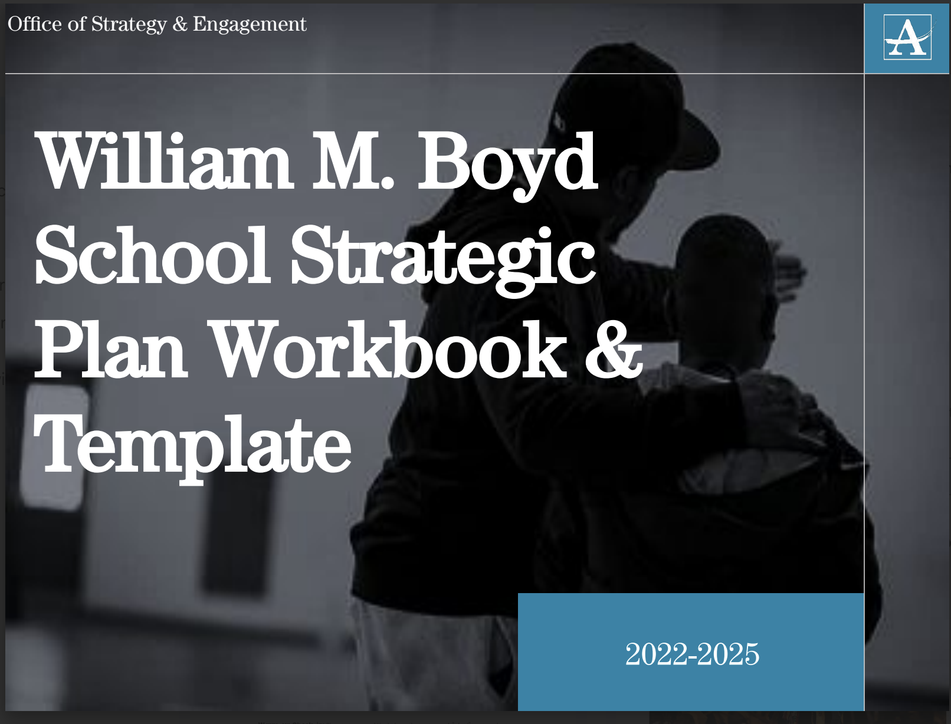
14

Slide 5
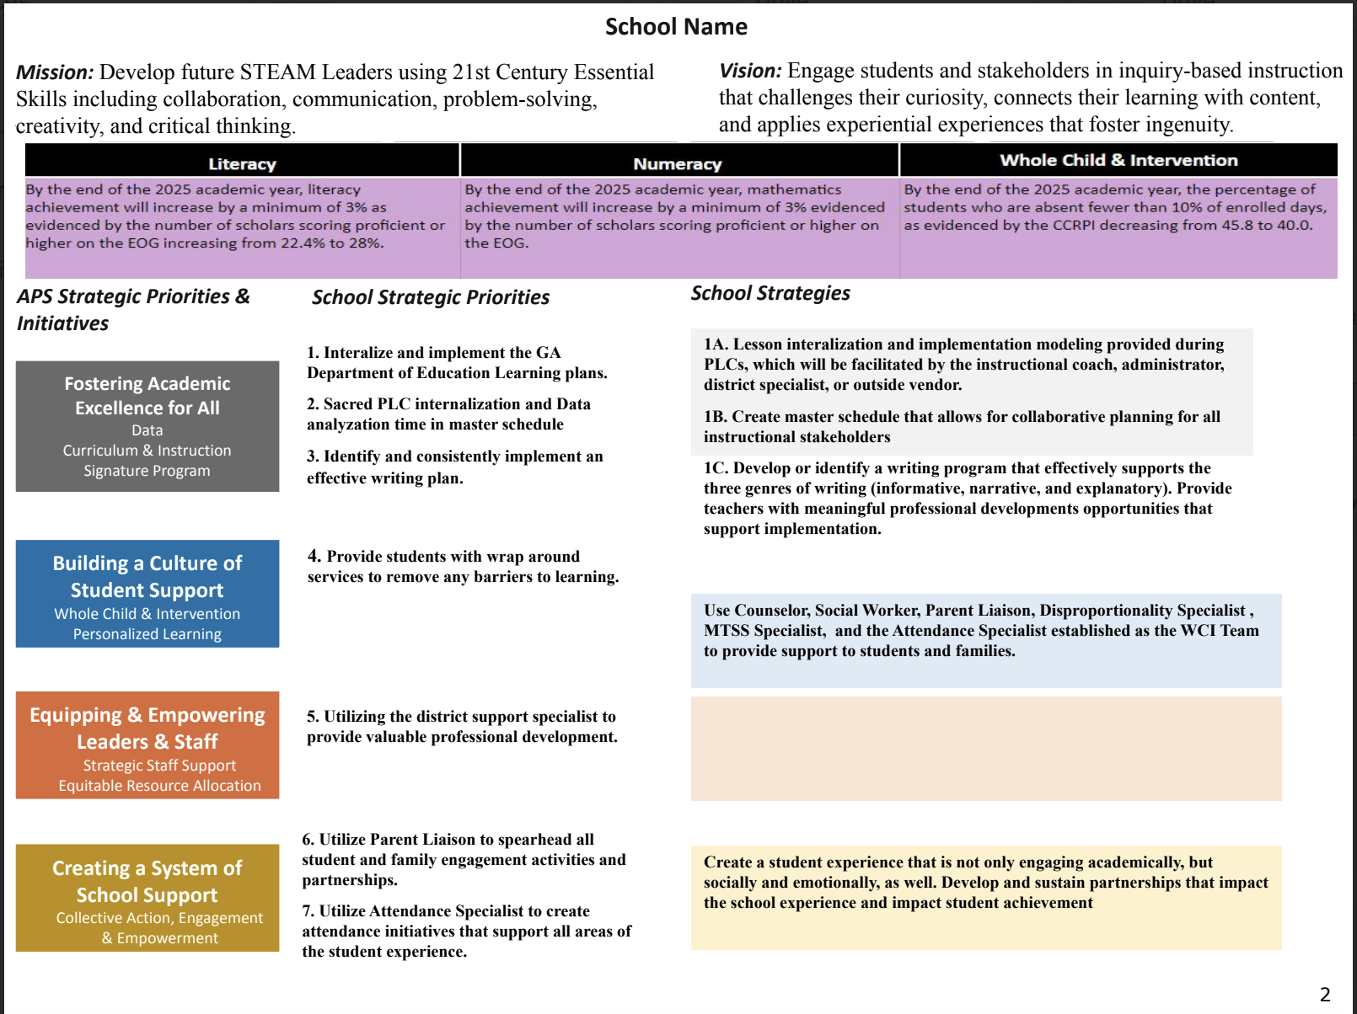
14

Slide 6
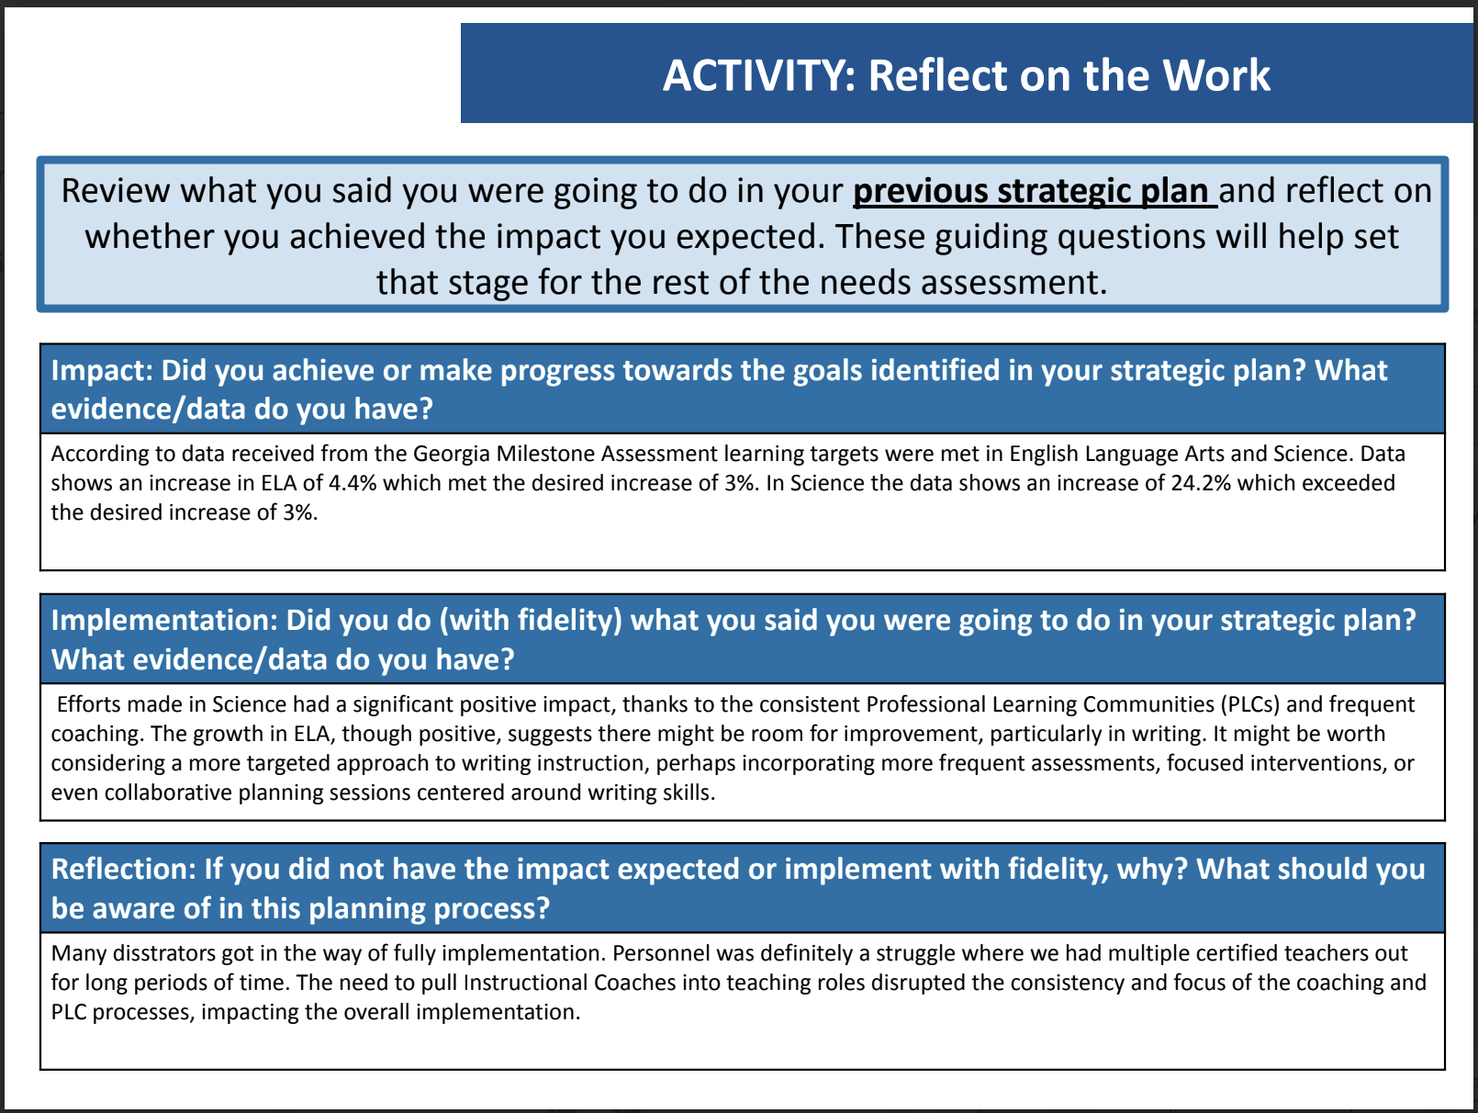
14

Slide 7
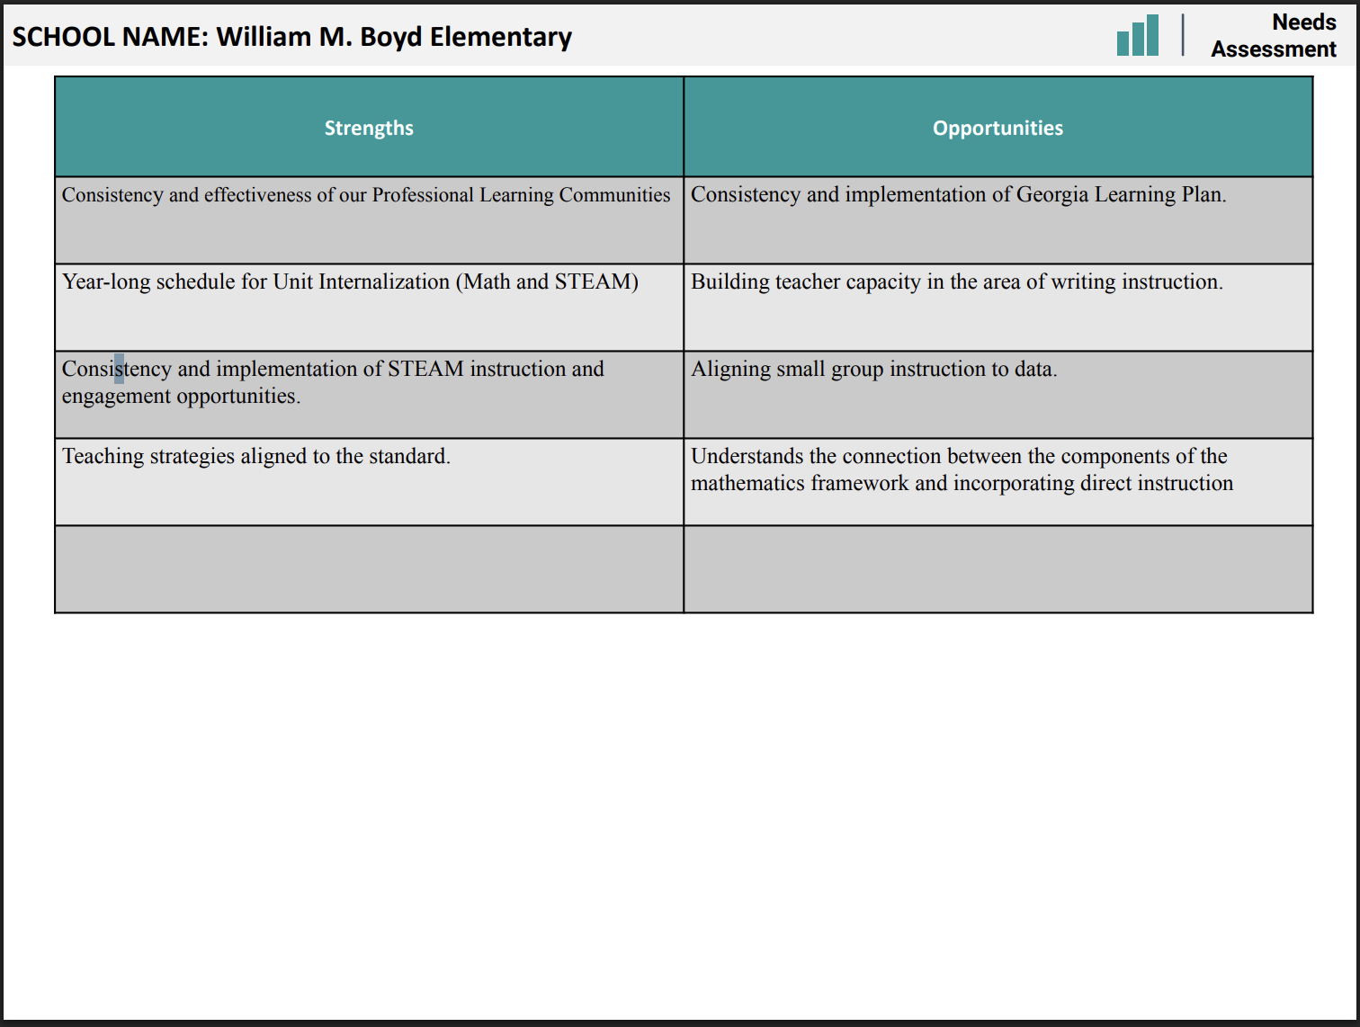

Slide 8
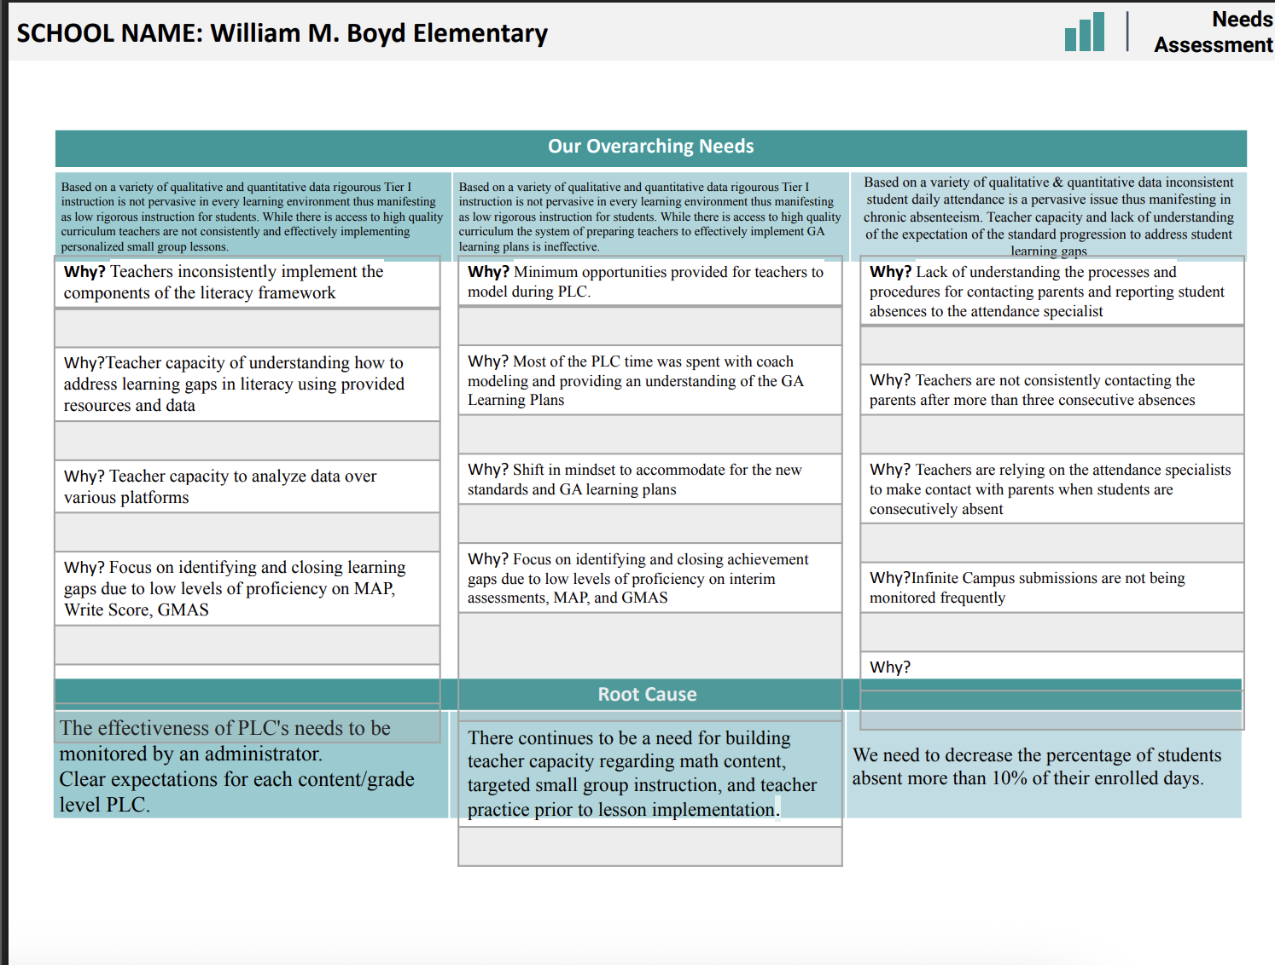

Slide 9
Strategic Plan
Priority Ranking
Insert the school’s priorities from Higher to Lower
Higher
Before Presenting to your GO Team:
Insert the Strategic Plan Ranking Slide from your last Fall 2024 Presentation
Lower

Slide 10
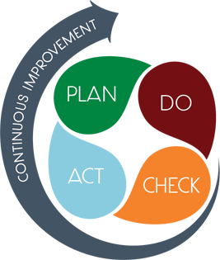
Connecting the Strategic plan &
Continuous Improvement Plan
Strategic Internalize and implement the GA Department of Education Learning plans. Sacred PLC internalization and Data analyzation time in master schedule. Identify and consistently implement an effective writing plan.
By the end of the 2025-2026 school year, the 3rd-5th grade students will increase scoring proficient or above from 19% (SY24-25) to 24% (SY25-26) on the spring 2026 EOG on ELA; 3rd-5th grade SWD students will increase scoring proficient or above from 0% (SY24-25) to 5% (SY25-26) on the spring EOG on ELA.
Subgroup Proficiency Students with Disabilities
Strategic Plan Priority
CIP SMART Goal
Key Indicator
Strategic Internalize and implement the GA Department of Education Learning plans. Sacred PLC internalization and Data analyzation time in master schedule. Identify and consistently implement an effective writing plan.
By the end of the 2025-2026 school year, the 3rd-5th grade students will increase scoring proficient or above from 23% (SY24-25) to 28% (SY25-26) on the spring 2025 EOG in Math; 3rd-5th grade SWD students will increase scoring proficient or above 5%.
Subgroup Proficiency Students with Disabilities
Utilize Parent Liaison to spearhead all student and family engagement activities and partnerships. Utilize Attendance Specialist to create attendance initiatives that support all areas of the student experience.
During the 2025-2026 school year, there will be an increase from 49.4% to at least 65%, reflecting a schoolwide commitment to attendance initiatives and proactive behavioral interventions, measured by the CCRPI attendance rate.
Attendance

Slide 11
Data
Discussion

Slide 12
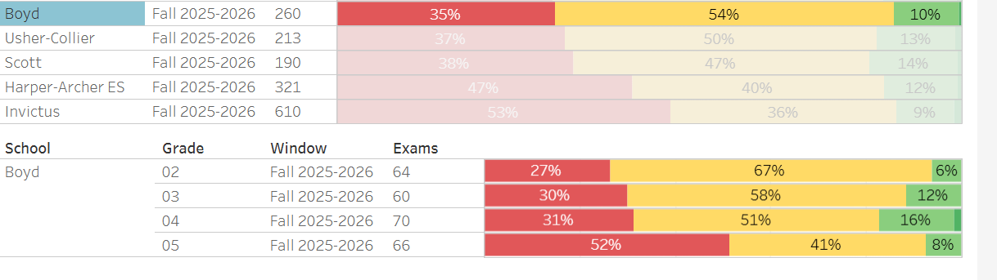
MAP Results
Math Grades 3-5

Slide 13
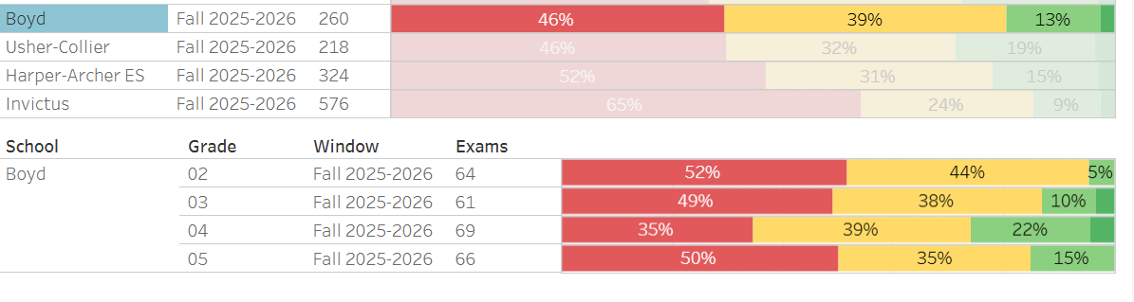
MAP Results
ELA Grades 3-5

Slide 14
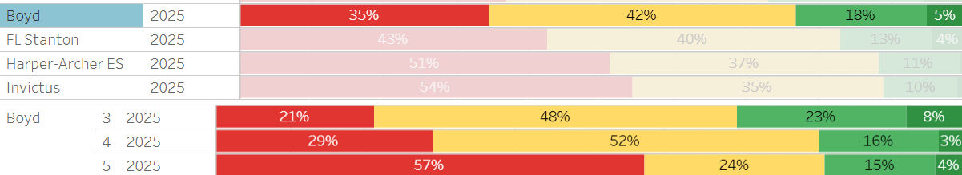
GMAS Results
Math Grades 3-5

Slide 15
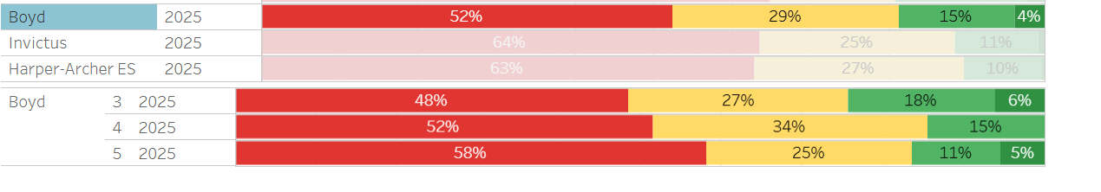
GMAS Results
ELA/RDG Grades 3-5

Slide 16
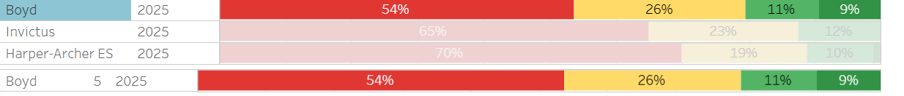
GMAS Results
Science Grades 3-5

Slide 17
Glows & Grows
Glows
Grows
GMAS - Over all the students who are supported within the general education environment showed significant growth
3rd grade – had the highest growth
Student buy-in with new HMH curriculum
District instructional support for ELA, Math and Science
GMAS – in 5th grade we saw a significant decline in all contents
No points were earned overall for DSE
Adjusting teaching staff to support student growth
Supporting PLCs, LP after school, and weekly data meetings
are we on target to successfully ACCOMPLISH our priorities?
IMPACT

Slide 18
GO Team Discussion:
Data Protocol
What do you notice?
What are your wonderings?
Based on our school’s trend data from MAP assessments and end-of-year test assessments, which student sub-groups and grade levels showed the most significant gaps or unexpected trends?
Based on our school’s trend data from MAP assessments, Milestones and other indicators, are there specific trends that require more focused attention?
What additional questions do you have?

Slide 19
Timeline for GO Teams
You are HERE
Fall 2021
GO Team Developed 2021-2025 Strategic Plan
1
Summer
School Leadership completed Needs Assessment and defined overarching needs
2
August
School Leadership completed Continuous Improvement Plan
3
Sept. – Dec.
GO Team reviews progress on current strategic plan.
GO Team develops 2025-2030 School Strategic Plan
4
Before Winter Break
GO Team will take action (vote) on the rank of the strategic plan priorities for SY26-27 in preparation for budget discussions.
5

Slide 20
Questions?

Slide 21
Principal’s Report

Slide 22



Please do ONLY if not presented to the GO Team at a previous meeting
(SCHOOL NAME)
LEVELING AND
FY26 BUDGET ADJUSTMENT
Template Last Revised: 9/4/2025

Slide 23


Enrollment
Projected Enrollment | 439
15-Day Count(08.22.25) Enrollment | 377
Difference | -62
Budget Adjustment* | $369,644 Reserve: $115,445 Title 1: -7500 Title 1 Family Engagement: -250 Hold Harmless: $261,949
*The budget adjustment reflects the impact of the following: Enrollment changes, school reserves, Title I Part A, Title I- Family Engagement
Hold harmless
To support academic stability in schools, budgets were not reduced beyond school reserves.
Notes:
Principals: Based on your15-Day count, please give your GO Team an overview of your projected vs. 8/22 enrolled numbers as well as information on your FY26 budget adjustment.

Slide 24
Plan for FY26 Leveling Reserve
$___-115,445___
Priorities | Strategies | Requests | Amount
Increase level of rigor and relevance (example- please remove) | Implementation of guided reading training for all staff (example- please remove) | Purchase an additional Teacher (example- please remove) | $84, 134 (example- please remove)
EXAMPLE
N/A
Notes:
Review the previously discussed plan for the FY26 Leveling Reserve as discussed by the GO Team in your Feb. 2025 Budget Feedback meeting and March 2025 Approval meeting.

Slide 25
Plan for FY26 Title I Holdback
$____7500___
Priorities | Strategies | Requests | Amount
Increase level of rigor and relevance (example- please remove) | Implementation of guided reading training for all staff (example- please remove) | Purchase an additional Teacher (example- please remove) | $84, 134 (example- please remove)
EXAMPLE
N/A
Notes:
Review the previously discussed plan for the FY26 Title I Holdback as discussed by the GO Team in your Feb. 2025 Budget Feedback meeting and March 2025 Approval meeting.

Slide 26
Summary of Changes as a Result of FY26 Budget Adjustment
Personnel Changes | Non-Personnel Changes
N/A
Summary of Changes
PRINCIPALS: Please provide a summary of the impact these changes and how it relates to your strategic plan here.

Slide 27


APS Forward 2040:
Reshaping the Future of Education
Taskforce Meetings
May 8, 2025 - Presentation
August 5, 2025- Presentation
Upcoming Public Meetings
October 20
November 10
Virtual – at Noon
In-person at 6PM at CLL (130 Trinity Ave)
UPDATE
Comprehensive Long-Range Facilities Plan
atlantapublicschools.us/APS2040
Notes:
Next on our agenda, we’d like to welcome our representative to the Long-Range Comprehensive Facilities Master Plan Taskforce. As many of you know, this taskforce plays a key role in shaping the future of our district’s facilities — ensuring they are aligned with projected enrollment, instructional needs, safety standards, and long-term community use."
Over the summer, the taskforce has been hard at work reviewing data, exploring options, and engaging in important planning conversations. [Name of Representative] will share an update on what’s been done so far, any key decisions or recommendations that have been made, and what’s ahead — including opportunities for the public to provide input.
[Allow the FMP representative to provide an update and answers questions. After this is concluded:]
Thank you [Name of Representative].
A report will be presented to the Board at its August 11 meeting, and the options will become public the week of August 18.
There are several upcoming public meetings where you can learn more and share your thoughts. The next public meetings are scheduled for: August 25, October 20, and November 10
On each date, there will be a virtual meeting at noon and an in-person meeting at the Central Office at 6PM.
I strongly encourage you all to attend these meetings. This is a critical time for public input, and your voice is essential.

Slide 28
Information about our school
September 26, 2025
Bring Your Parents to School Day 9am – 11am
Urban Recipe – Food Distribution 11am – 1pm (Main Lobby)

Slide 29


SAVE THE DATE
IN-PERSON
G3 Summit
Go.Grow.Govern.
Bring the full GO Team
Come ready to collaborate, contribute, and create the future!
Saturday
September 27
8:30 AM – 2:30 PM
Come learn more about:
Your school’s 2025-2030 Strategic Plan
Stakeholder Engagement
Charter System
…and much more
Atlanta College & Career Academy
1090 Windsor St SW
Notes:
Before we move on, I want to highlight an important upcoming event: the G3 Summit on Saturday, September 27 at the Atlanta College and Career Academy.
We need as many GO Team members as possible to attend — this is a critical opportunity to come together, in person, and shape the future of our schools. Strategic planning for 2025–2030 is underway, and your voices, ideas, and leadership are essential.
You’ll be learning about your school’s new strategic plan, best practices for stakeholder engagement, and how this work connects to APS Forward 2040 — plus much more.
Please save the date and plan to attend! Come ready to collaborate, contribute, and create the future together.
More information will be coming soon.

Slide 30
Questions?

